Slide 1
Statistical Thinking with Python Part 1
Spring, 2018

Slide 2
Course Overview
https://campus.datacamp.com/courses/statistical-thinking-in-python-part-1/
Graphical exploratory data analysis
Histogram
Bee Swarm Plot
ECDF
Quantitative exploratory data analysis
Summary statistics: mean, standard deviation, variance, correlation
Probabilistic thinking: Discrete variables
np.random module
Bernulli trial, Binomial distribution
Probability Mass Function, Cumulative Distribution Function
Poisson Distribution
Probabilistic thinking: Continuous variables
np.random.normal
Probability Density Function
Normal distribution, Normal CDF
Exponential distribution
Simulating

Slide 3
Data Science Tools in Python

Slide 4
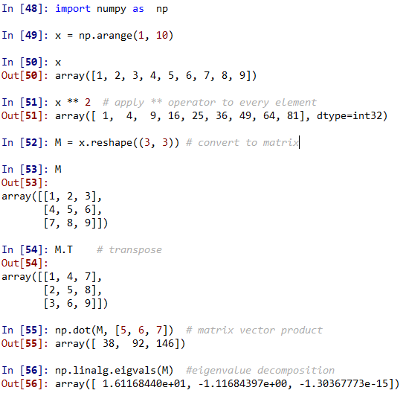
NumPy
Convert Python Lists to NumPy arrays
Arrays can be transformed into multidimensional objects – matrices
Can perform linear algebra operations:
Transpose
vector multiplication
eigenvalues
http://cs231n.github.io/python-numpy-tutorial/

Slide 5
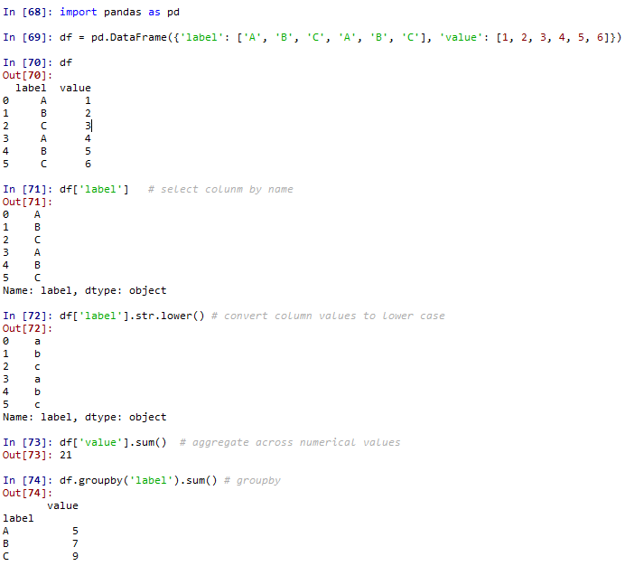
Pandas
Data Frames with column names
String operations on string data
Math on numerical
Database-like joining and grouping
Aggregation across numerical values

Slide 6
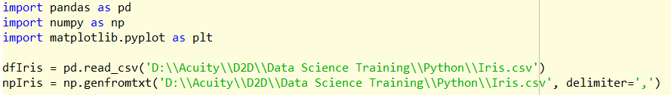
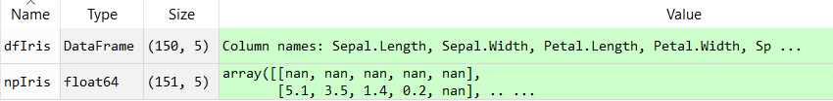
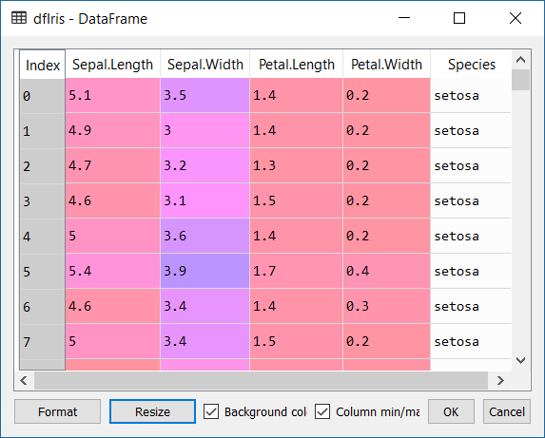
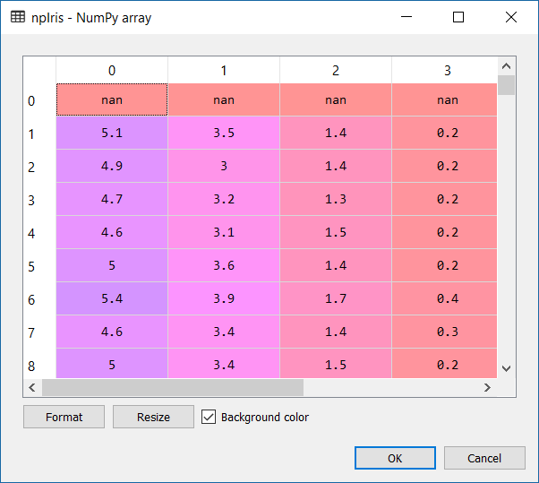
Import Data

Slide 7
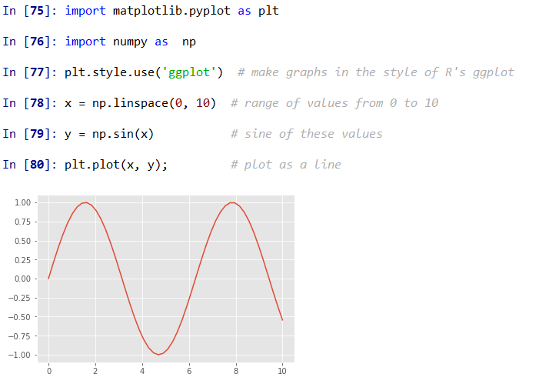
Matplotlib
Most popular scientific visualization package in Python
Powerful library for creating a large range of plots
Interface is sometimes overly verbose
https://matplotlib.org/index.html
https://matplotlib.org/gallery.html

Slide 8
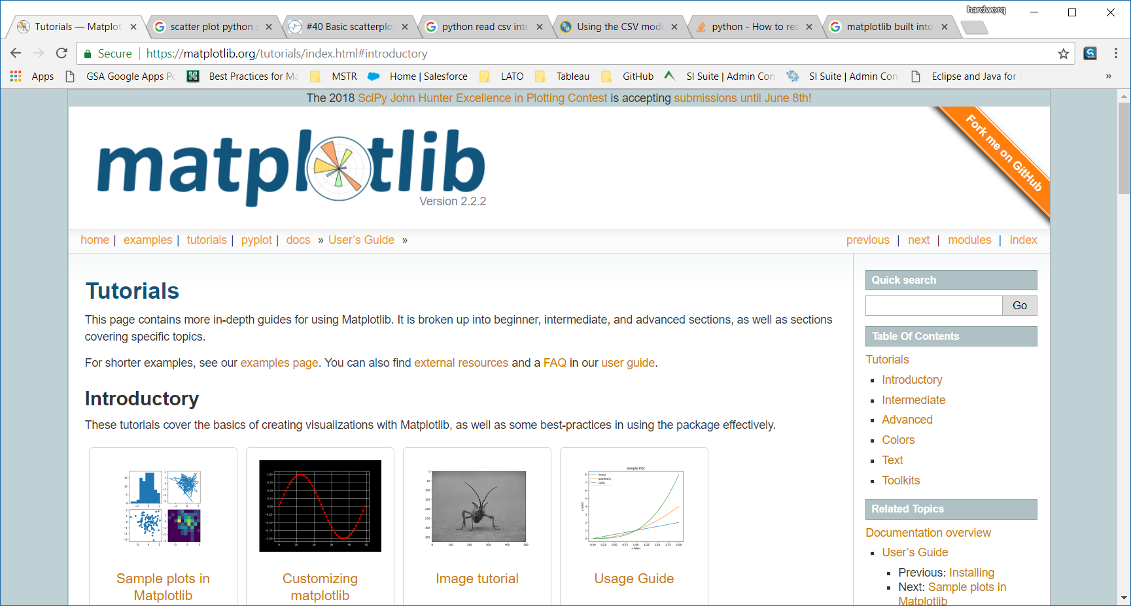
https://matplotlib.org/tutorials/index.html#introductory

Slide 9
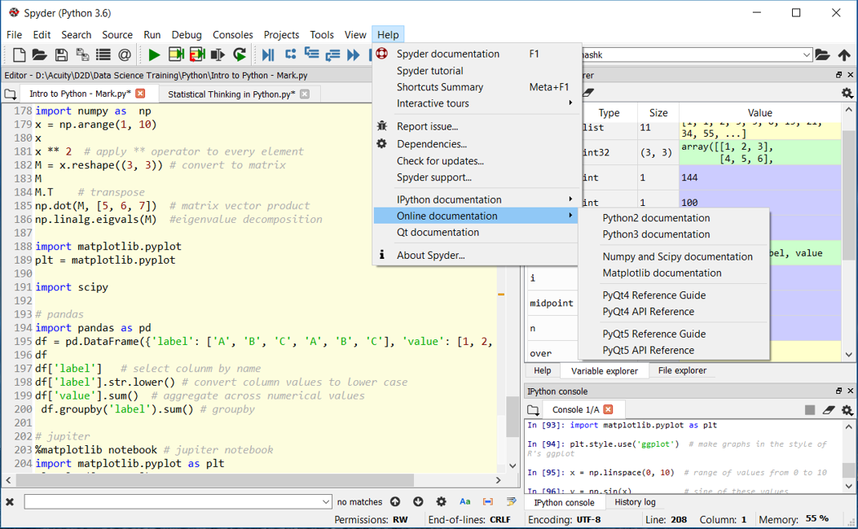
NumPy, SciPy, and Matplotlib Help in Spyder
Pandas help not yet integrated, go to:
https://pandas.pydata.org/

Slide 10
Statistics and Probability

Slide 11
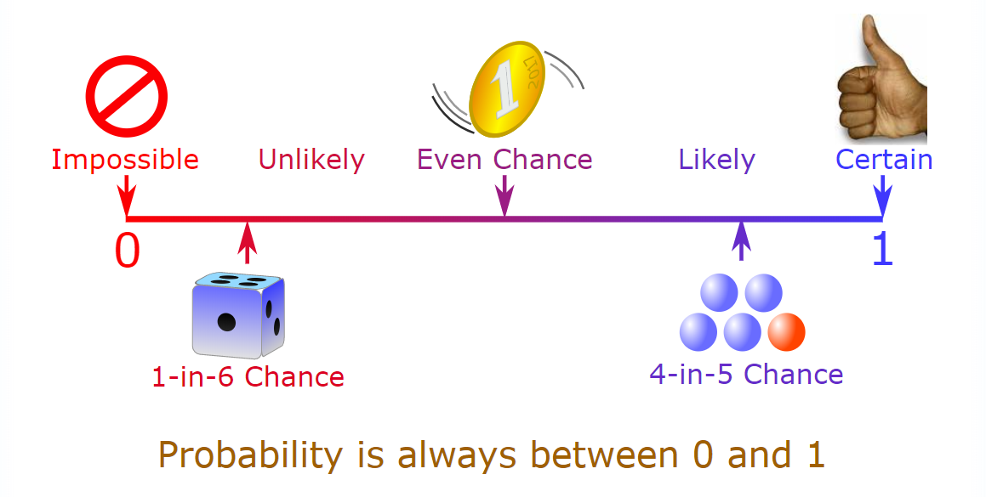
What is Probability?
The extent to which an event is likely to occur, measured by the ratio of the favorable cases to the whole number of cases possible
P(A or B) = P(A) + P(B) P(A & B) = P(A) * P(B)
Example:
Fair coin: two equal possibilities
P(Head) = P(Tail) = 1/2
Probability of Head after Tail = 1/2 * 1/2 = 1/4

Slide 12
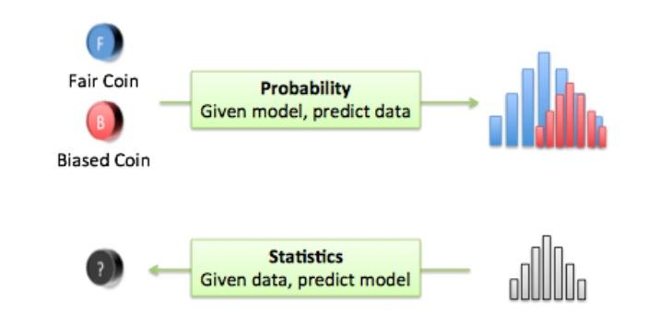
Probability and Statistics Where is the connection?
A (very) facilitated explanation:
Probability: from model to data distribution (create/analyze a model and predict an outcome)
Statistics: from data distribution to model (what effects the outcome)
Connection – math behind models and data distribution

Slide 13
Exploratory Data Analysis
Examine distribution of variables
What values variables can take
How often they take those values
Establish hierarchies for categorical variables (dimensions)
Compute descriptive statistics (for numeric variables)
Visualize with plots
Data visualization shifts the balance from cognition (thinking) to perception (seeing)
Seeing is handled by the visual cortex located in the rear of the brain, is extremely fast and efficient
We see immediately, with little effort

Slide 14
Descriptive Statistics
Descriptive statistics quantitatively describe or summarize features of data
Simple summaries of a variable
Main descriptive statistics:
Distribution
Frequency (of occurrences)
Central Tendency
Mean (Average)
Median
Mode
Dispersion
Range
Variance
Standard Deviation

Slide 15
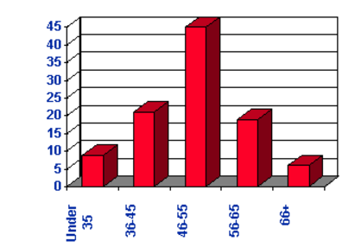
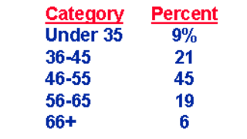
Descriptive Statistics: Distribution
A frequency of individual values or ranges of values for a variable
Can be a table or a graph (histogram)
Example: Percent of income
of five age groups

Slide 16
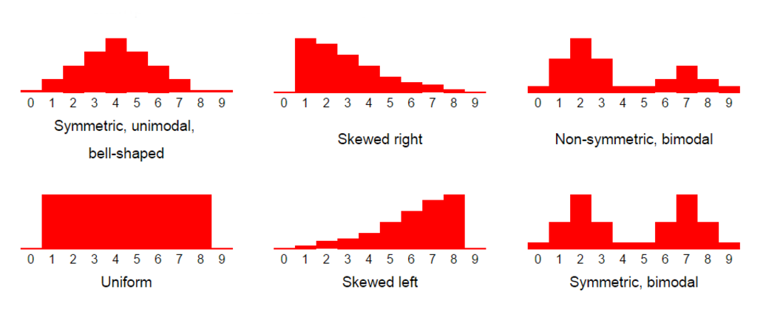
Histograms

Slide 17
Descriptive Statistics: Central Tendency
Central Tendency - one number to describe the variable
Three ways to estimate
Mean (bias, average)
A = [15, 20, 21, 20, 36, 15, 25, 15]
Mean(A) = sum(A)/count(A) = 167/8 = 20.875
- Highly affected by outliers
Median
A = [15,15,15,20,20,21,25,36]
Median(A) = 20 (the mid point of A)
- Almost not affected by outliers
Mode
The most frequently occurring number
Mode(A) = 15
Can be applied to both quantitative and categorical data
Note: for normal distribution Mean = Median = Mode

Slide 18
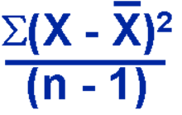
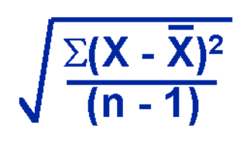
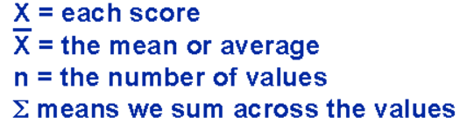
Descriptive Statistics: Dispersion
Three common ways to estimate
Range: max - min
A = [15, 20, 21, 20, 36, 15, 25, 15]
Range(A) = 36 – 15 = 21
Note: a big outlier can greatly influence a result!
Variance
Show the relation of each value to the mean
(variance around average)
Standard Deviation
A square root of variance

Slide 19
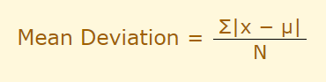
Why Do We Square Differences in Variance and Standard Deviation?
Imaging a data set
A = [4, 4, 0, -4, -4] Average(A) = 0
If we would not square differences, the negatives will compensate the positives and we would not get a true perception of the dispersion, i.e.:
(4 – 0) + (4 – 0) + 0 + (-4 – 0) + (-4 – 0) = 0
Can we take absolutes? Yes, this will be called Mean Deviation
However, Standard Deviation has proven to work better on most of datasets and is used way more often
Exercise: compute Mean Deviation and Standard Deviations for
A = [7, 1, -6, -2]

Slide 20
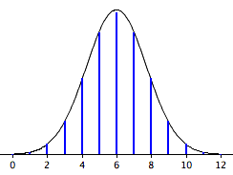
Bernoulli Trial Binomial and Normal Distributions
Bernoulli trial (or binomial trial) is a random experiment with exactly two possible outcomes, "success" and "failure", in which the probability of success is the same every time the experiment is conducted
e.g. coin toss
Binomial distribution is a sum of independent Bernoulli trials
e.g. six consecutive coin tosses
A distribution of a discrete random variable
For a large number of evens approaches normal distribution curve
Normal distribution (Gaussian) is a probability distribution of a (truly) random continuous variable
Normal
Binomial

Slide 21
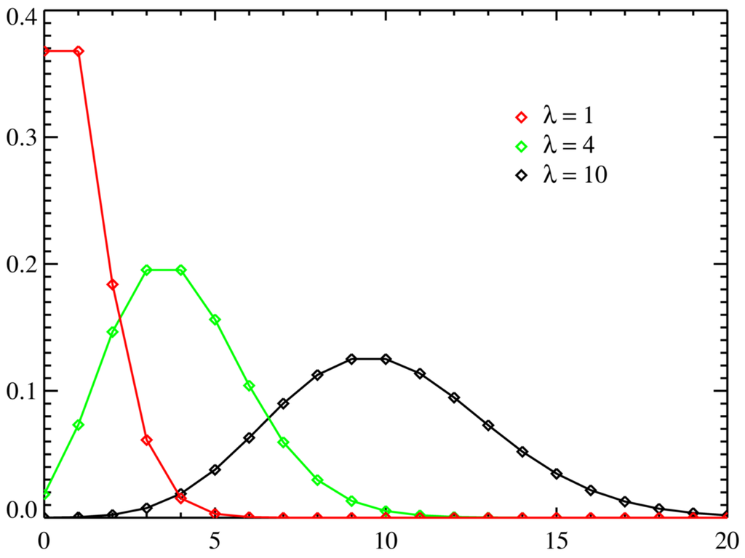
Poisson Distribution
Poisson
Poisson distribution describes probability of a certain number of events (discrete variable) within a certain period of time (place, etc.), e.g. cars passing traffic light, radioactive decay, incoming phone calls…
For large number of events approaches normal

Slide 22
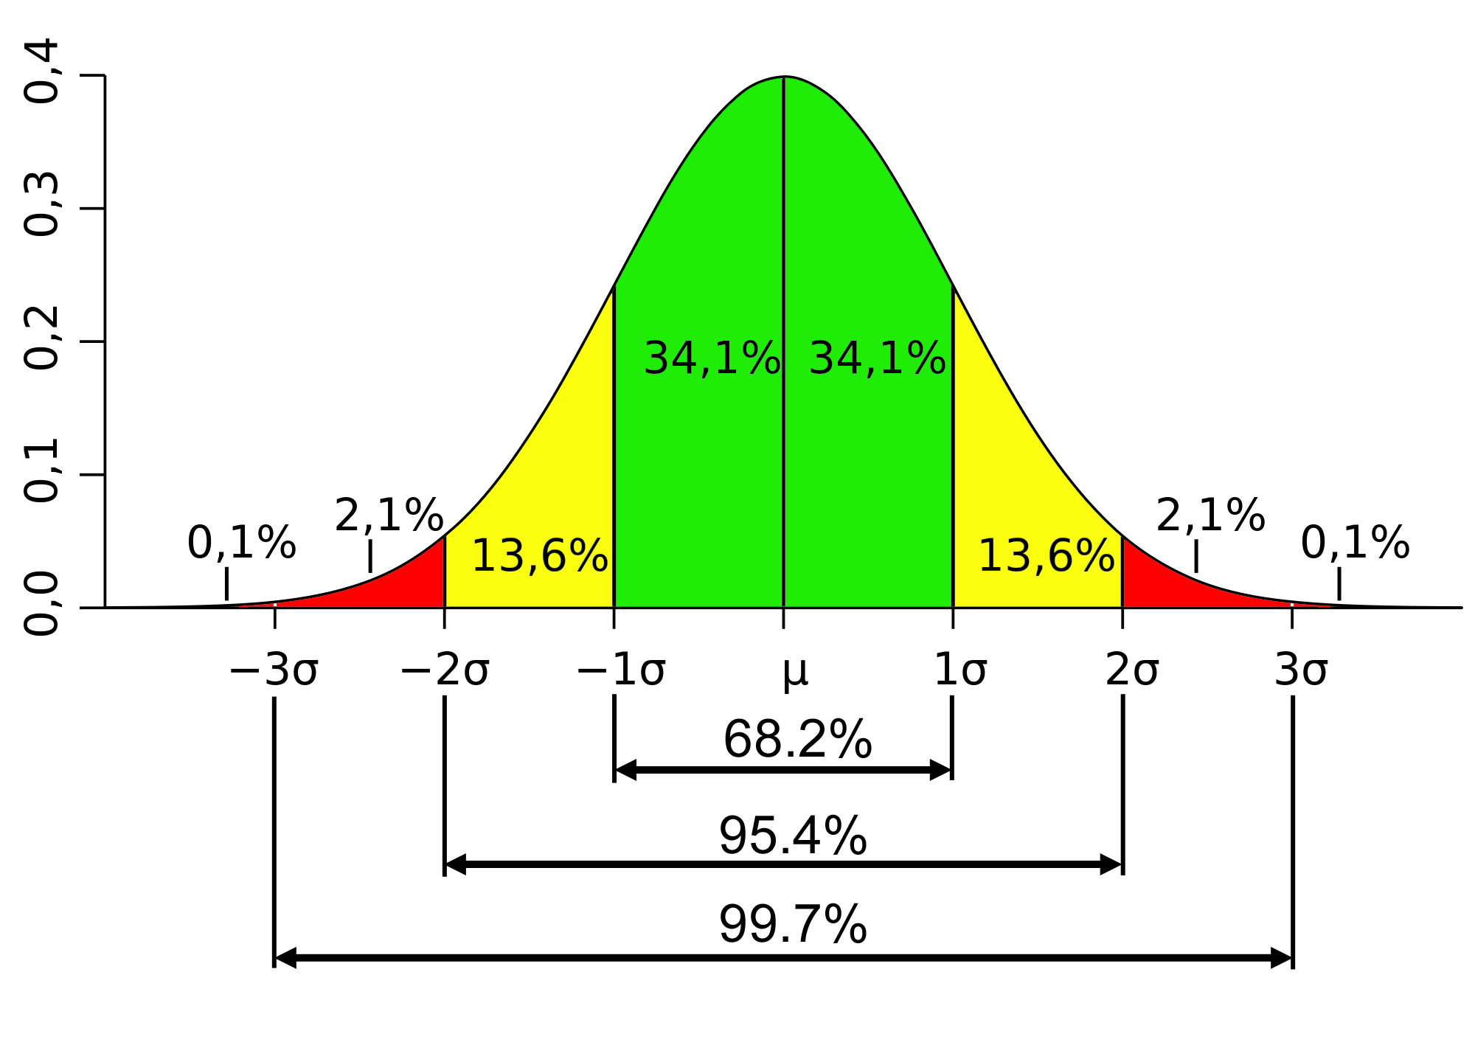
Normal Distribution and Standard Deviation
Normal Distribution
Mean / Average
One Standard Deviation
Two Standard Deviations

Slide 23
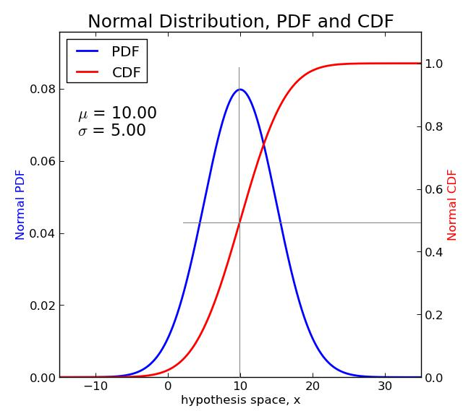
PDF and CDF for Normal Distribution (CDF is integral of PDF)
Probability
is value on y- axis
Probability is
area under the blue curve is
“D” in PDF is “Density” – continuous variable
“M” in PMF is “Mass” – discrete variable

Slide 24
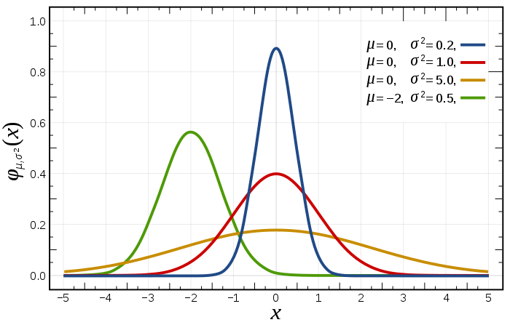
PDF with Different Means and STD

Slide 25
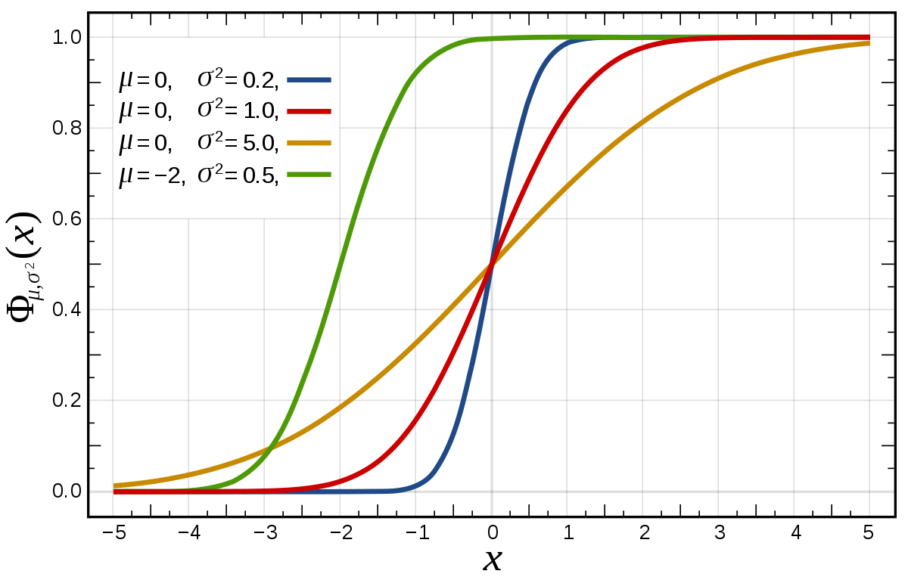
CDF with Different Means and STD

Slide 26
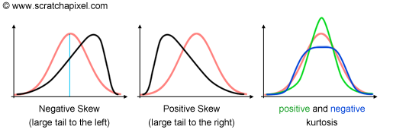
Skew(ness) and Kurtosis
Skew is a measure of “lack of symmetry” – the bigger is the skew the more asymmetric is the distribution
Kurtosis is a measure of
“Peakedness” (Wolfram MathWorld)
Combined weight of the “tails” relative to the rest of the distribution (Dr. Donald Wheeler)
Normal distribution Skew = 0, Kurtosis = 3

Slide 27
Covariance and Correlation
Both describe how two variables deviate from expected values (means/averages)
Covariance is average of the products of deviations of each variable from its mean
Correlation (coefficient) is “normalized” dimensionless covariance, i.e.
Correlation(A,B) = Covariance(A,B) / ((Standard Deviation(A))(Standard Deviation(B)))
Example
A = [3, 2, 4, 5, 6] Average(A) = 4
B = [9, 7, 12, 15, 17] Average(B) = 12
Covariance(A,B) =
= ((3 – 4)(9 – 12) + (2 – 4)(7 – 12) + (4 – 4)(12 – 12) + (5 – 4)(15 – 12) + (6 – 4)(17 – 12))/5 =
= 5.2
Exercise: use Excel to compute covariance and correlation

Slide 28
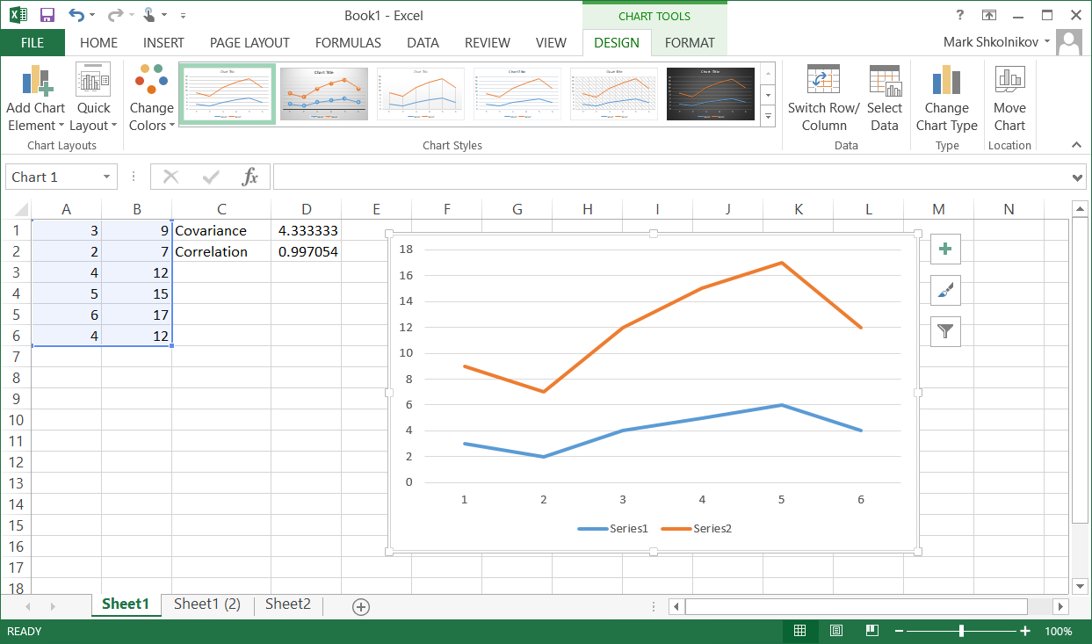
Exercise
Compute Covariance and Correlation Coefficient
For A and B
For A and A

Slide 29
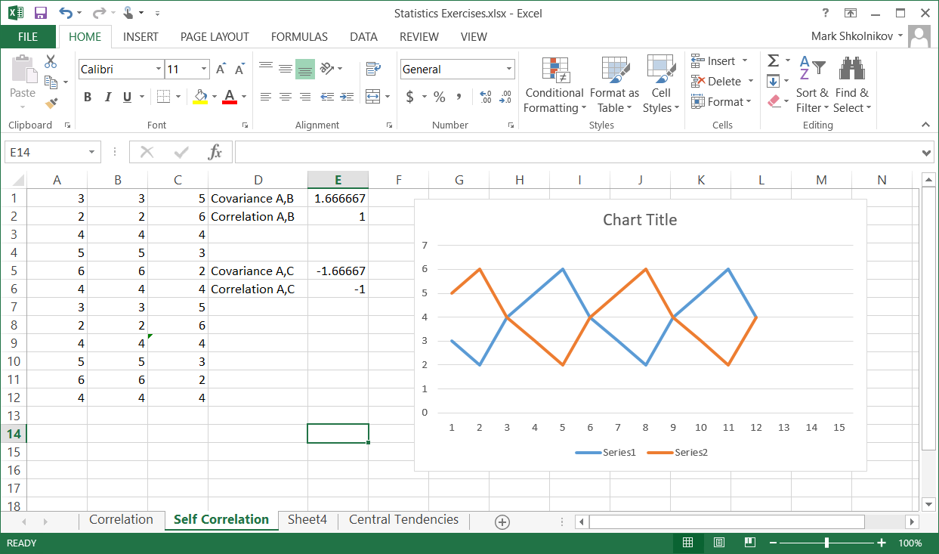
Exercise (cont.)
Compute Covariance and Correlation Coefficient
For A and C, where C is shifted A

Slide 30
Exercises
https://campus.datacamp.com/courses/statistical-thinking-in-python-part-1/

Slide 31
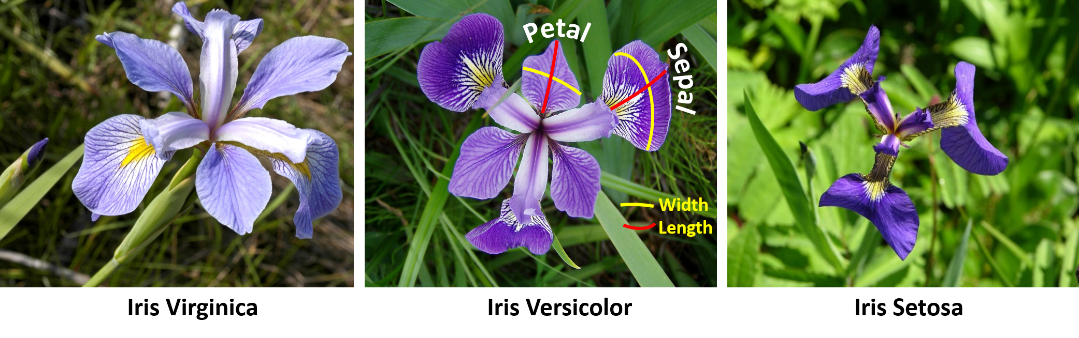
Iris Flower

Slide 32
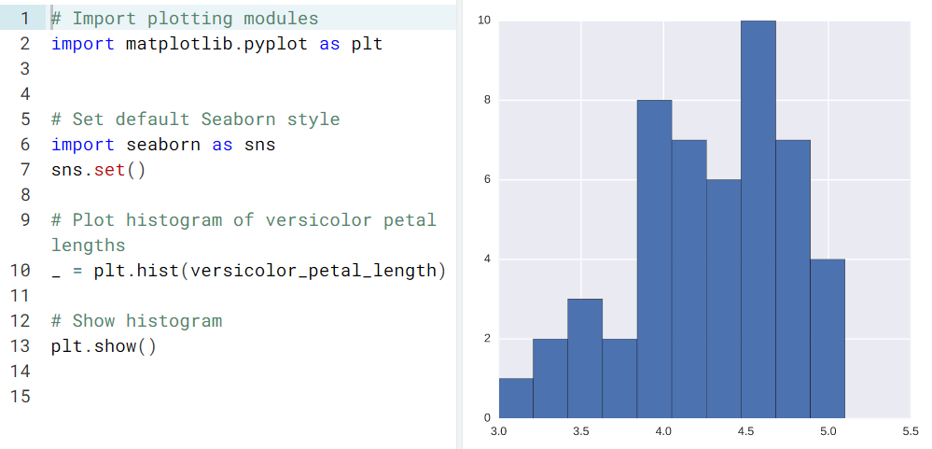
Plotting a histogram of iris data
“_” – general purpose “throwaway” variable

Slide 33
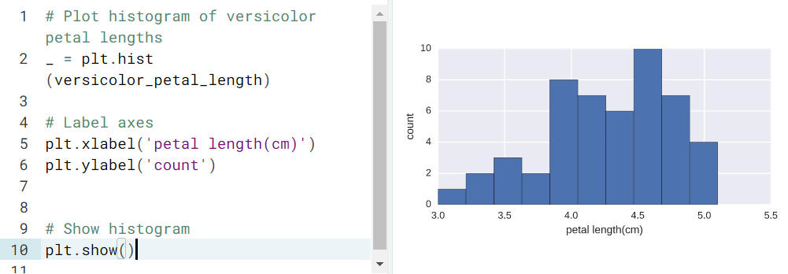
Axis labels!

Slide 34
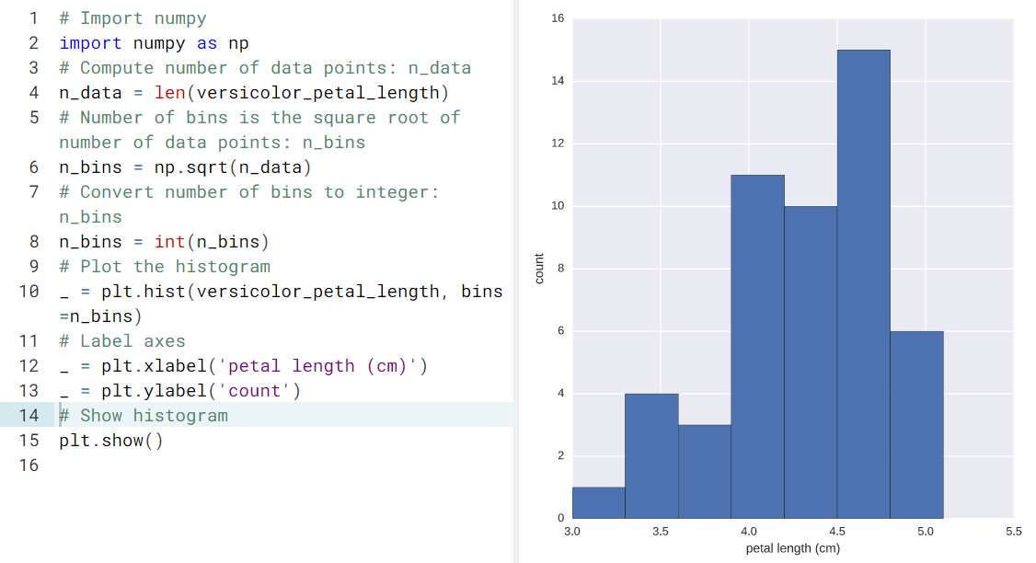
Adjusting the number of bins in a histogram

Slide 35
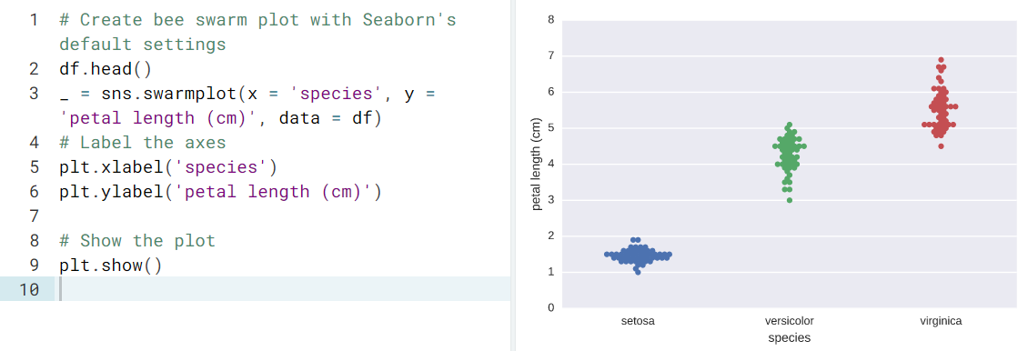
Bee swarm plot

Slide 36
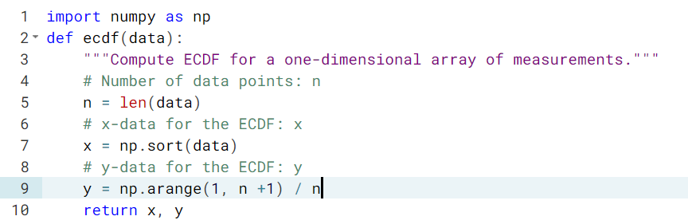
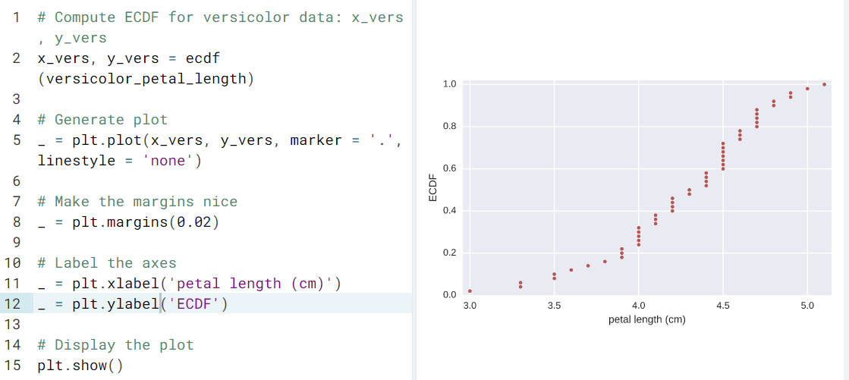
Empirical cumulative distribution function

Slide 37
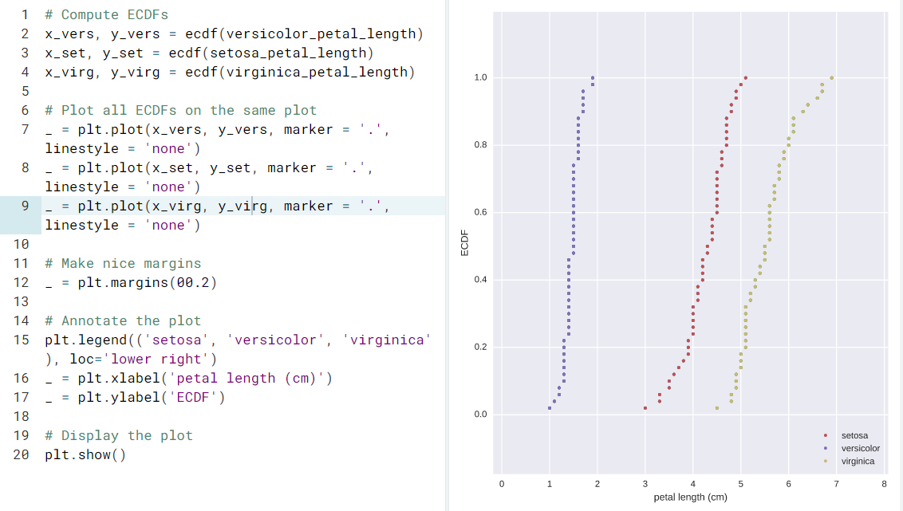
Comparison of ECDFs

Slide 38
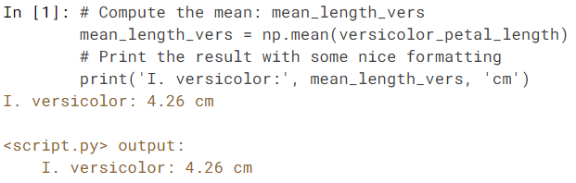
Computing means

Slide 39
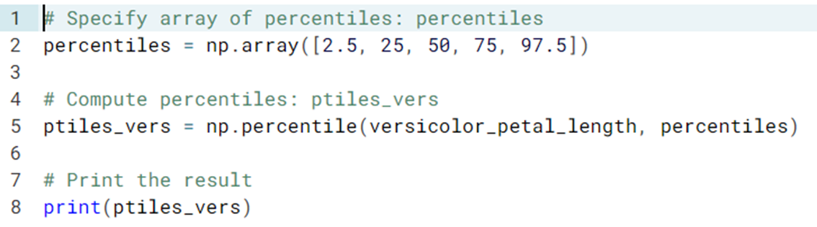
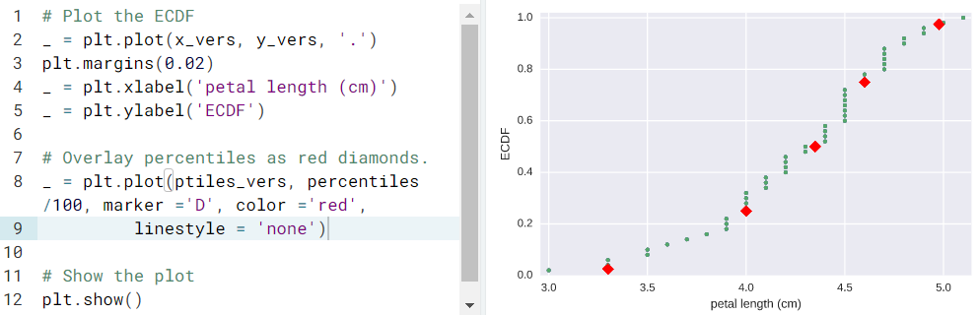
Comparing percentiles to ECDF

Slide 40
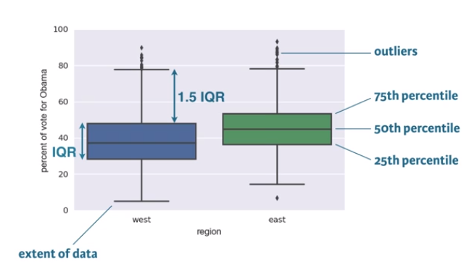
Box Plots

Slide 41
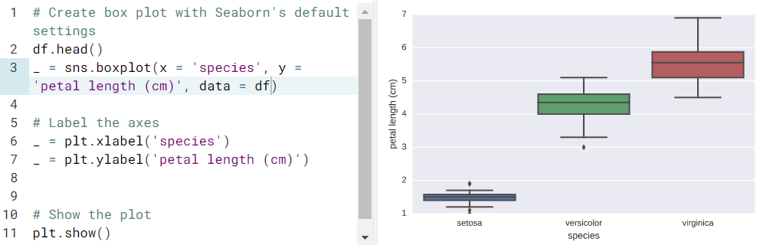
Box-and-whisker plot

Slide 42
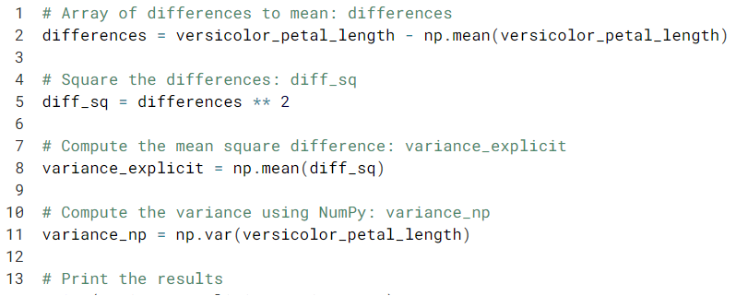
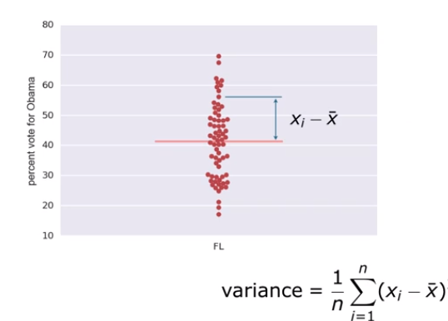
Variance

Slide 43
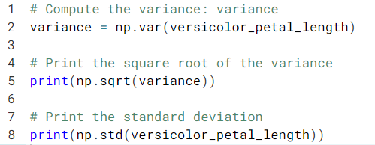
Standard Deviation

Slide 44
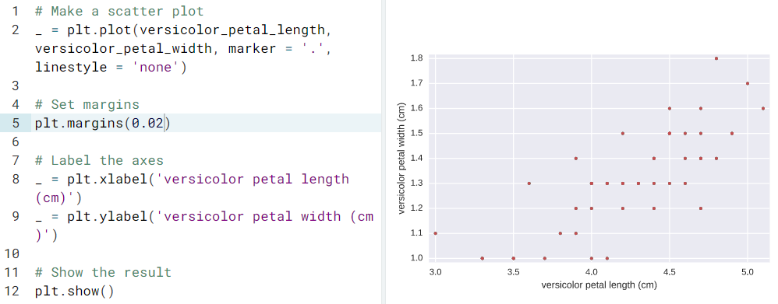
Scatter plot

Slide 45
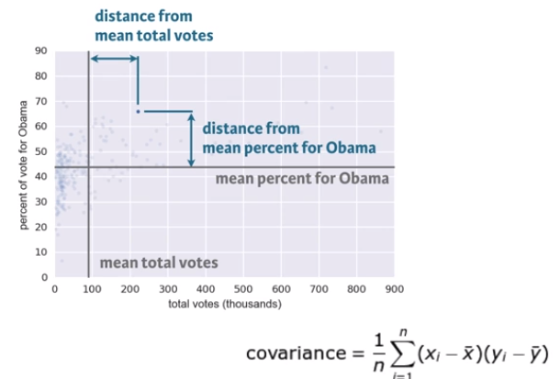
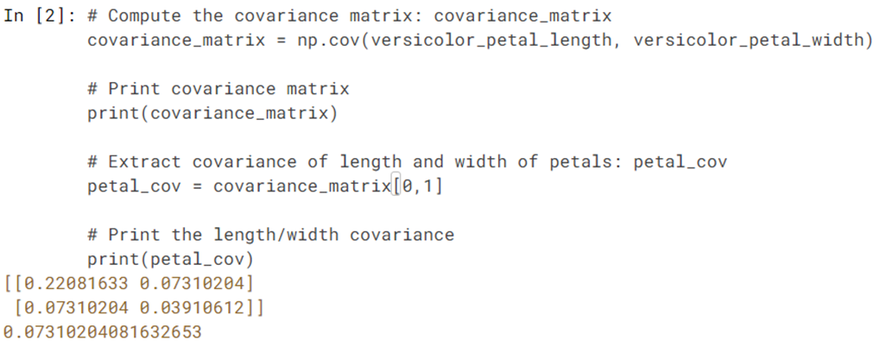
Covariance

Slide 46
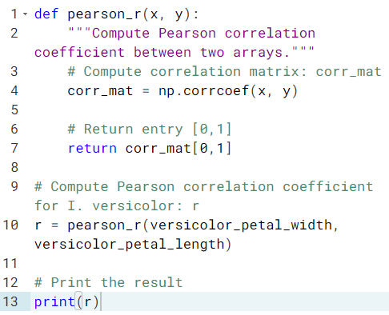
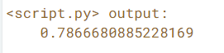
Correlation

Slide 47
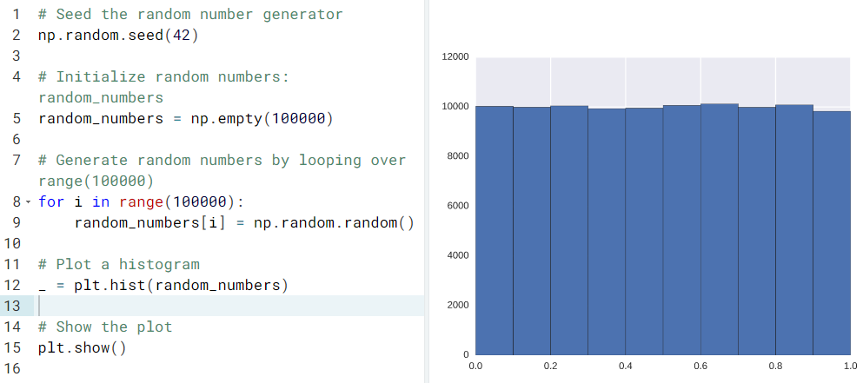
Generating random numbers using the np.random module

Slide 48
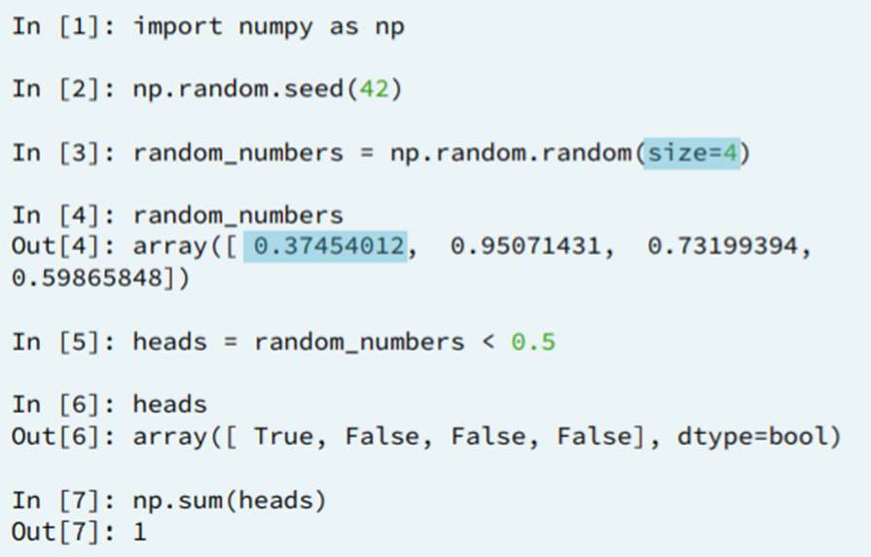
np.random

Slide 49

np.random module and Bernoulli trials

Slide 50

How many defaults might we expect?

Slide 51


Will the bank fail?

Slide 52

Sampling out of the Binomial distribution

Slide 53

Plotting the Binomial PMF

Slide 54

Relationship between Binomial and Poisson distributions

Slide 55


Was 2015 anomalous?

Slide 56

The Normal PDF

Slide 57

The Normal CDF

Slide 58

Are the Belmont Stakes results Normally distributed?

Slide 59

What are the chances of a horse matching or beating Secretariat's record?

Slide 60


Simulate a story ((hitting cycle in baseball)

Slide 61
Resources
Official Python Docs
https://www.python.org/doc/
https://docs.python.org/3/reference/index.html
Free eBook : O’REILLY’s A WhirlWind Tour of Python
http://www.oreilly.com/programming/free/a-whirlwind-tour-of-python.csp
https://github.com/jakevdp/WhirlwindTourOfPython/
Matplotlib
https://matplotlib.org/index.html
Statistics - Basics
http://www.statisticshowto.com/statistics-basics/
https://www.socialresearchmethods.net/kb/index.php
A semester-long course in Statistics
http://online.stanford.edu/course/probability-and-statistics-self-paced

Slide 62

Questions?

